Slide 1
LOC Management App
The App allows Desk officers to consolidate LOC related data on a centralized software and derive various reports as needed. The following slides list the features of the application.

Slide 2
Sections
The application id divided into the following sections:
Administration
This section lists all the configuration options to control the applications behavior.
LOC
Here we can manage the LOCs
Project
Here we can manage the Projects,Prequalification and Contracts under them.
Reports
This section has Standard Reports and also a Report builder to extract user defined reports.
There is also a Map Report to view projects on a Map.

Slide 3
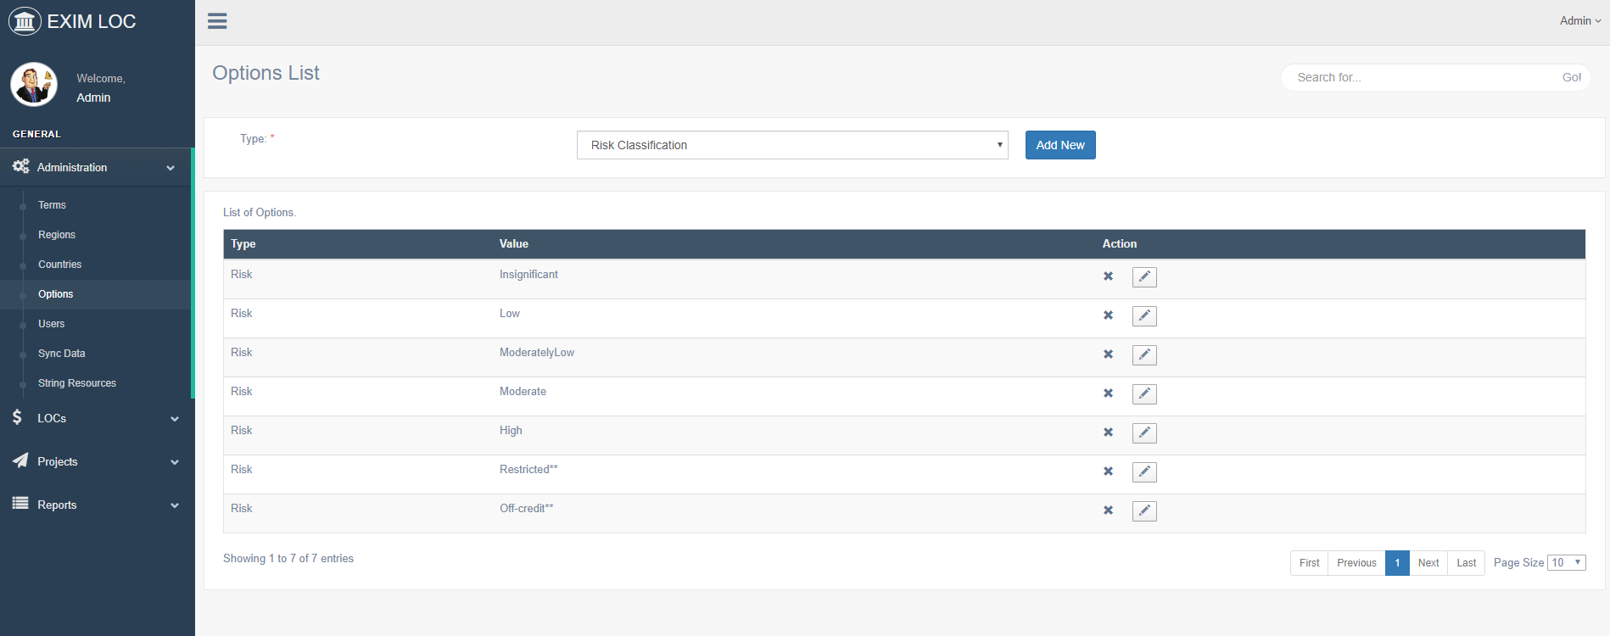
Admin Section

Slide 4
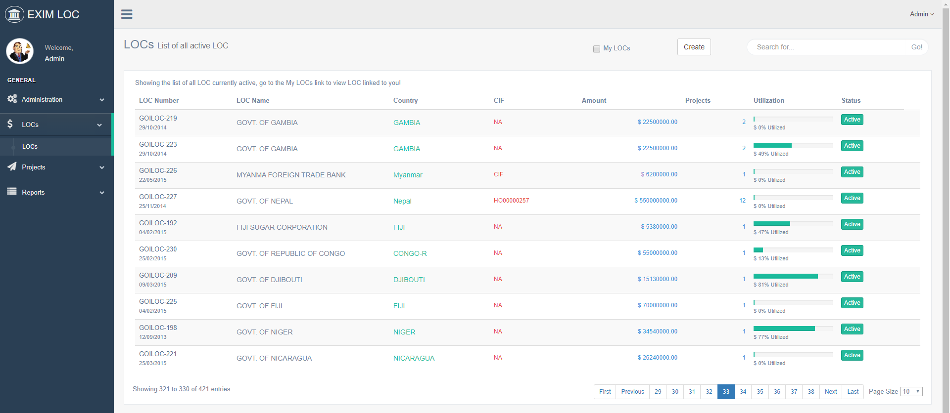
LOC-List

Slide 5
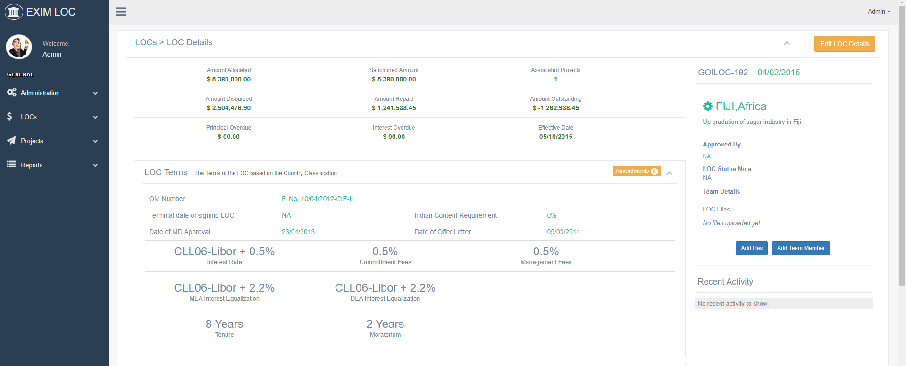
LOC-Details

Slide 6
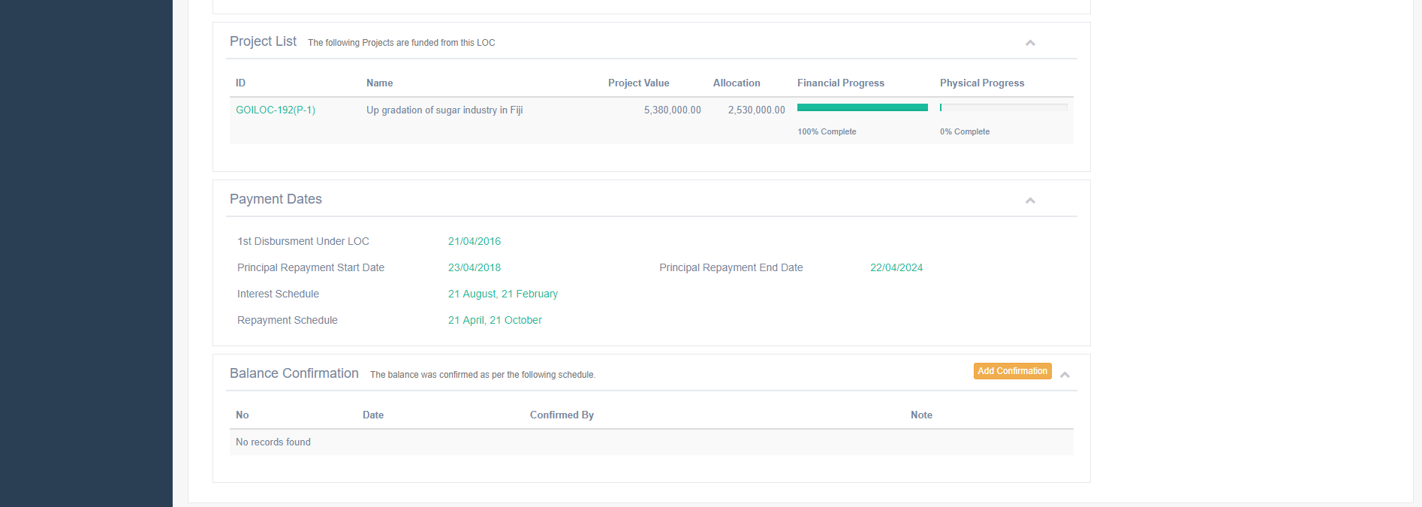
LOC-Project Listing, Payment Details, Balance Confirmation.

Slide 7
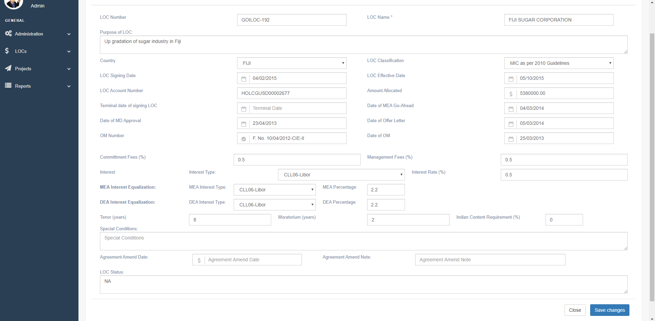
LOC-Edit Details

Slide 8
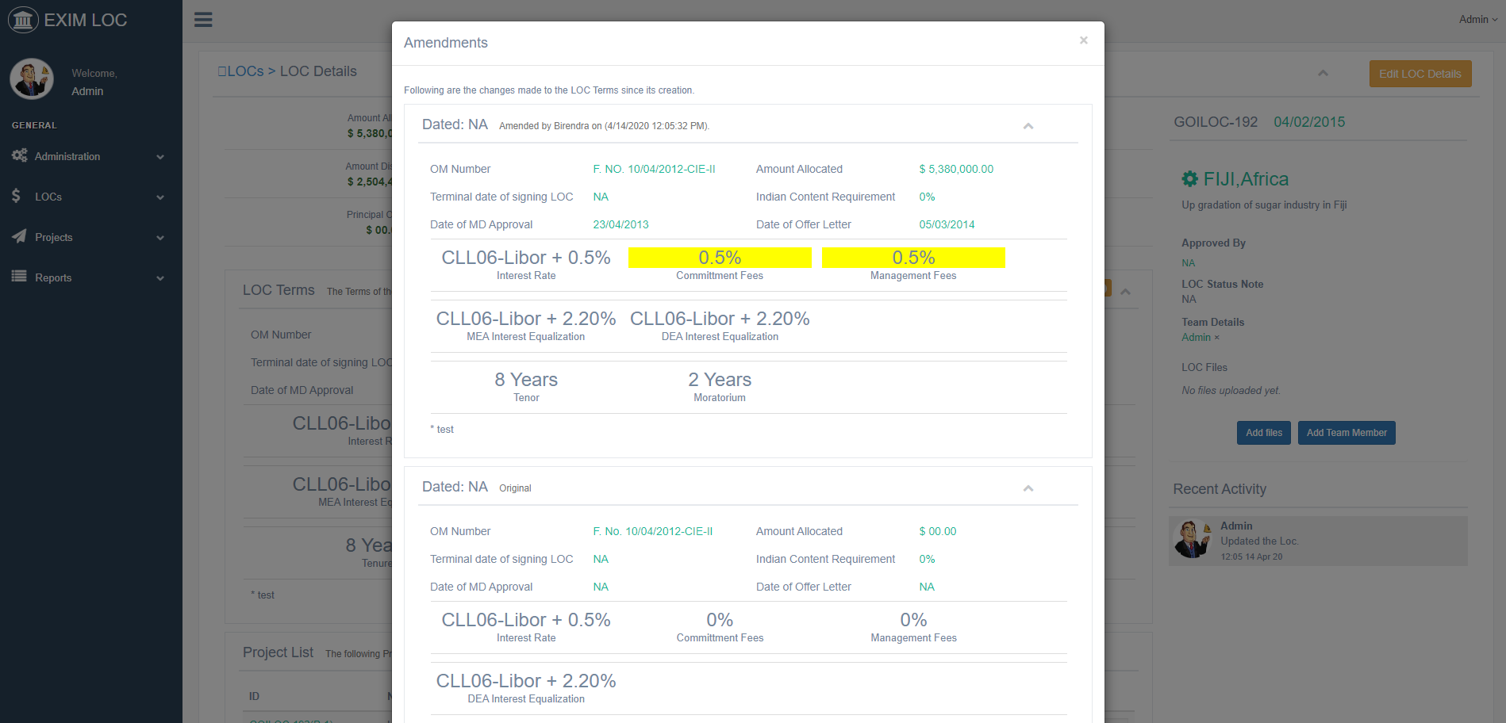
LOC-Amendments

Slide 9
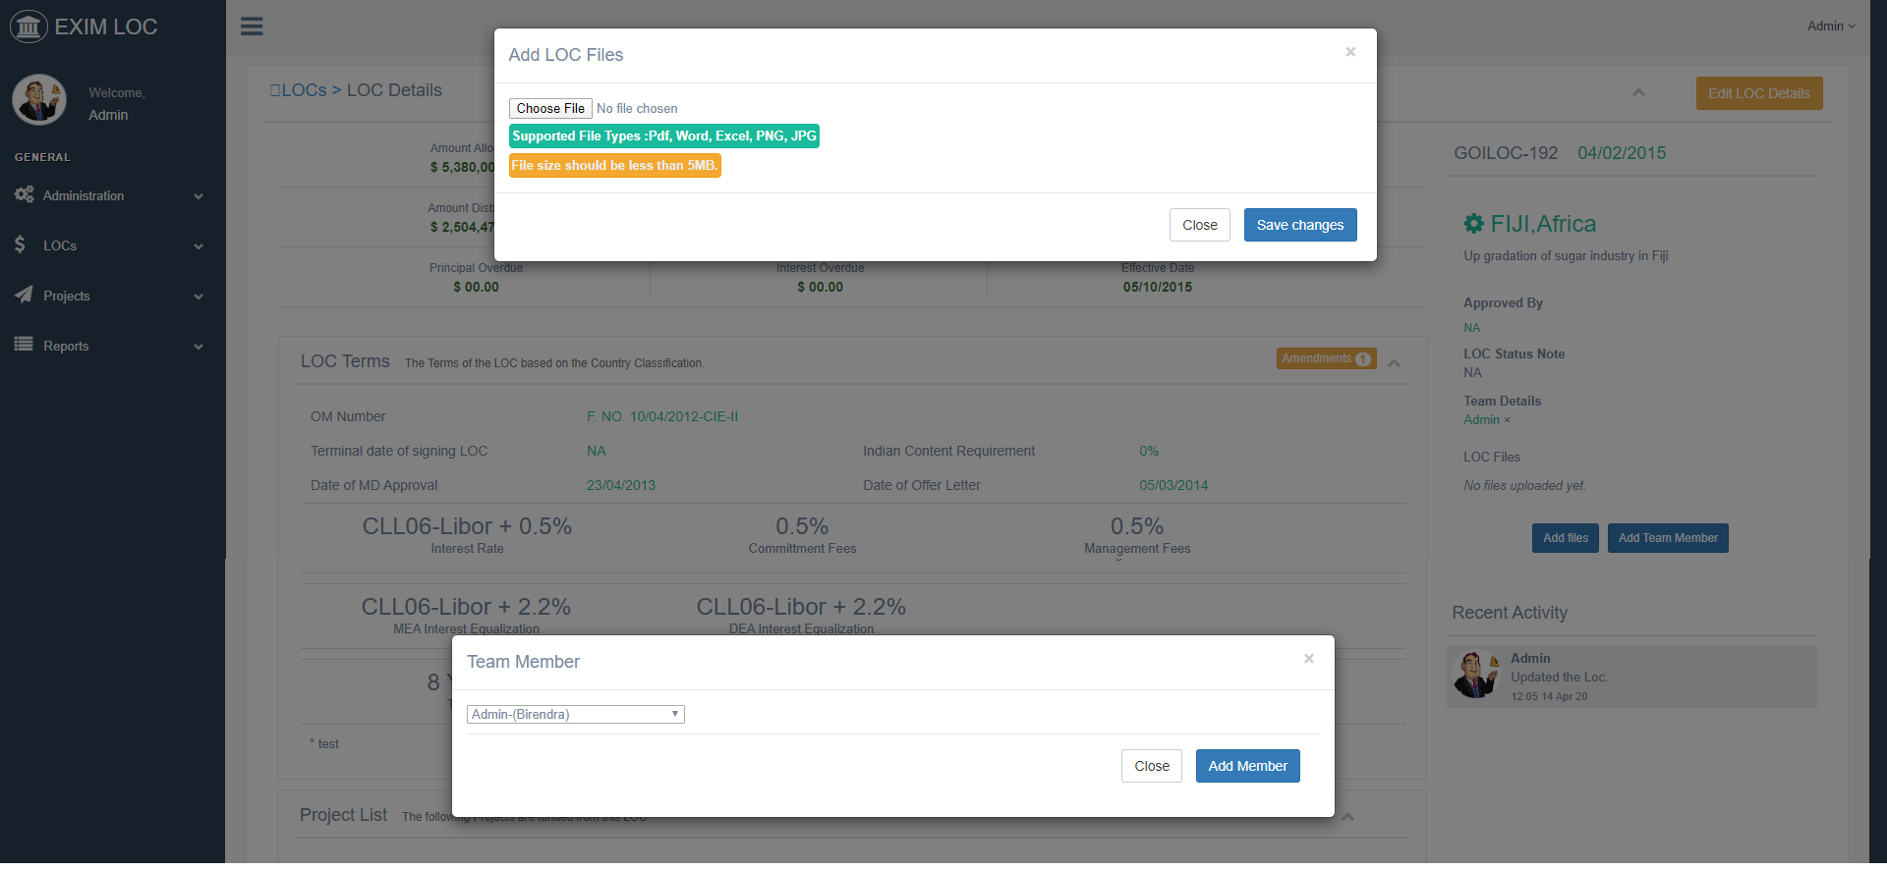
LOC-Add Files, Add Team Members

Slide 10
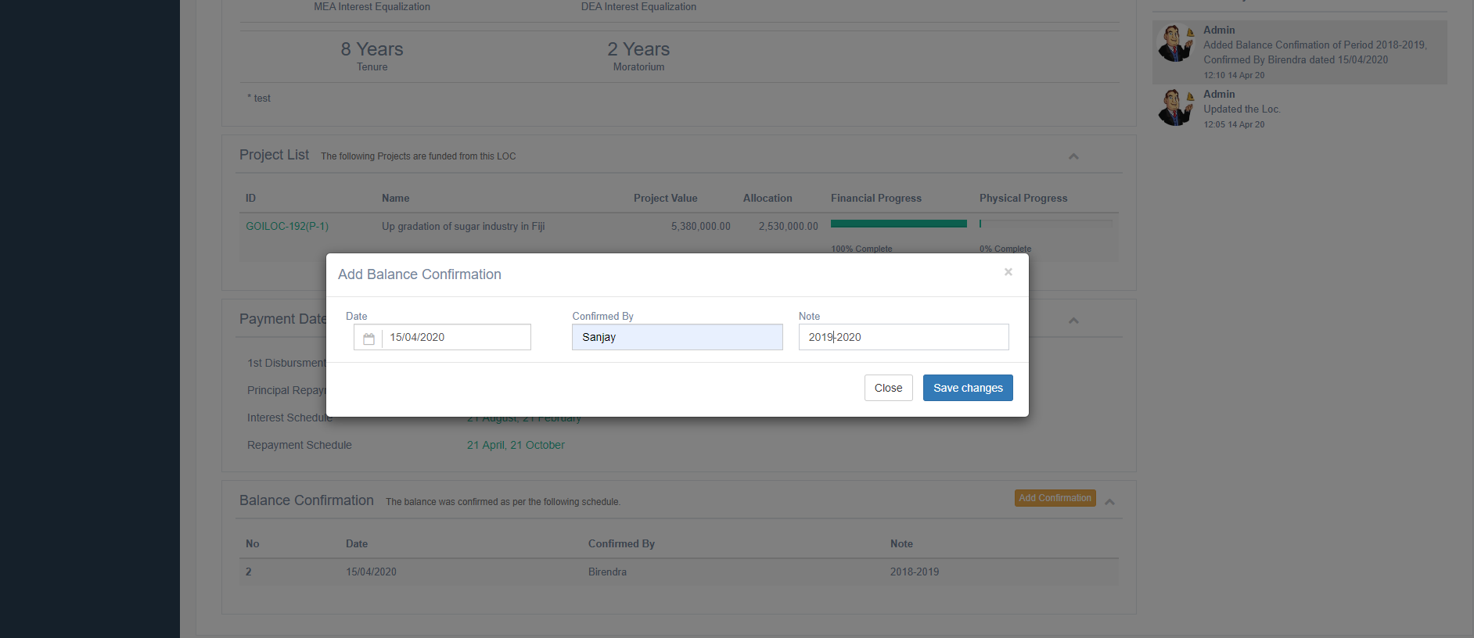
LOC-Add balance Confirmation

Slide 11
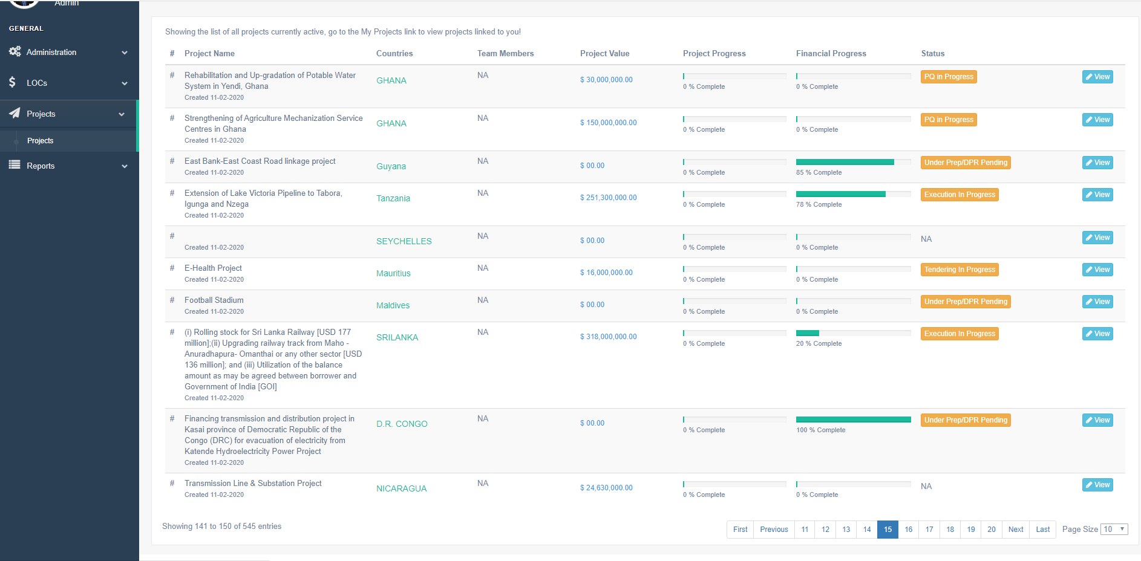
Project- Listing

Slide 12
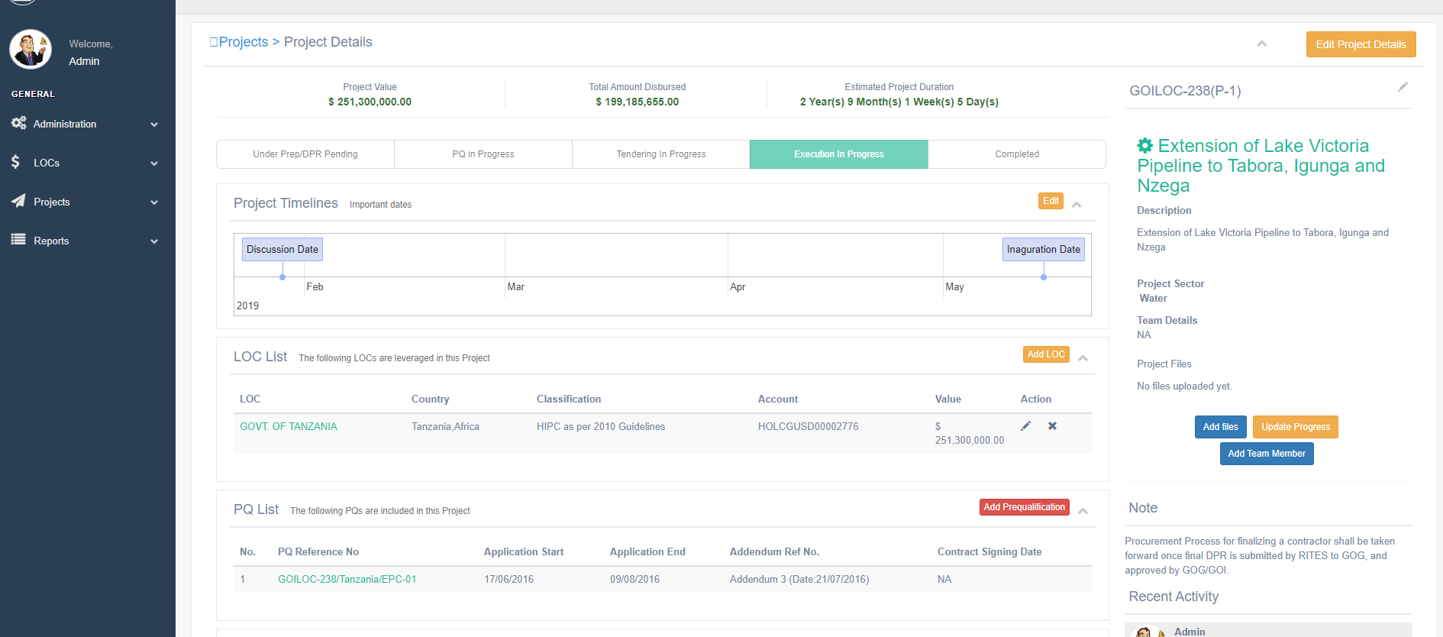
Project- Details, Timelines, Funding LOCs, PQs

Slide 13
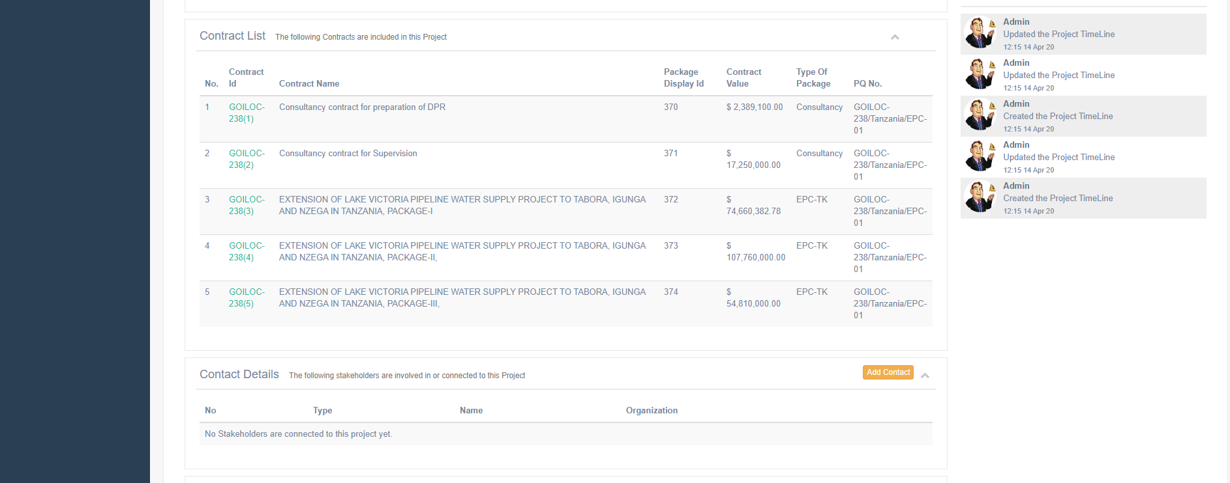
Project- Contracts under Project and Project Contacts

Slide 14
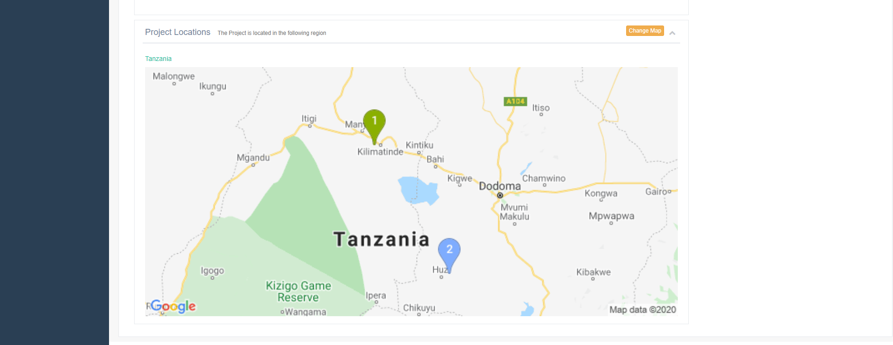
Project- Location on Map

Slide 15
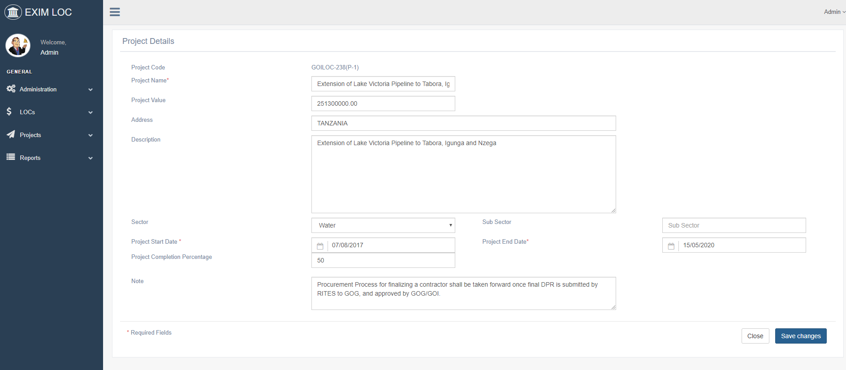
Project-Edit Details

Slide 16
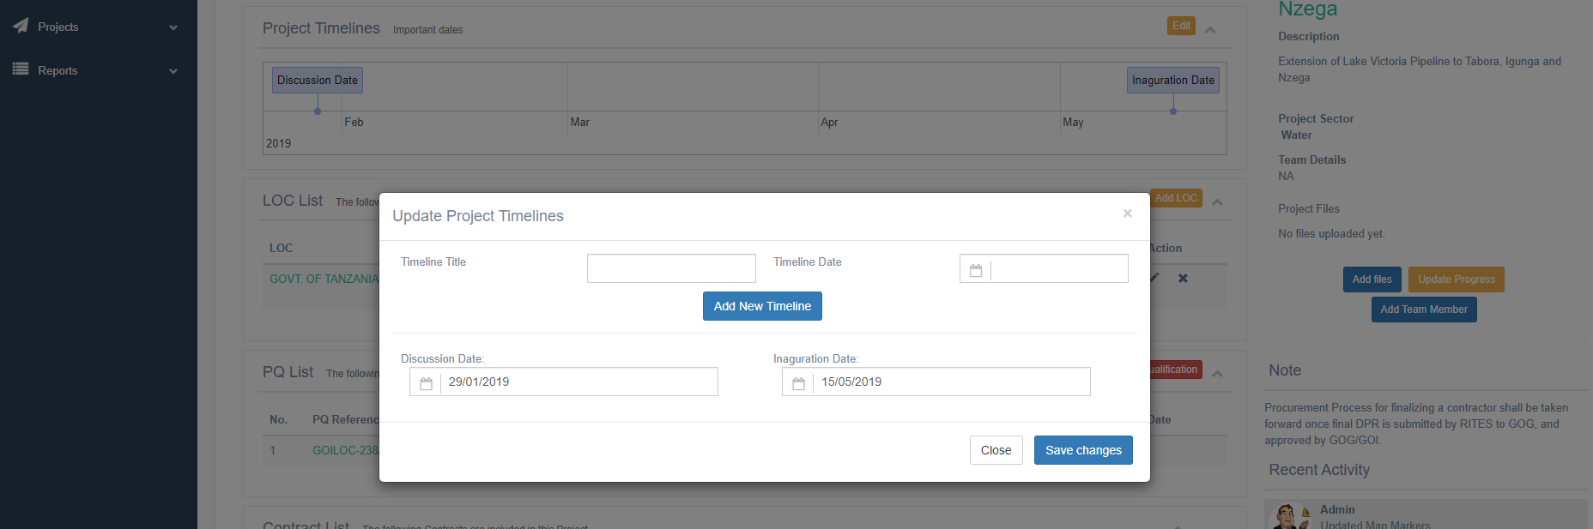
Project-Manage Important Dates

Slide 17
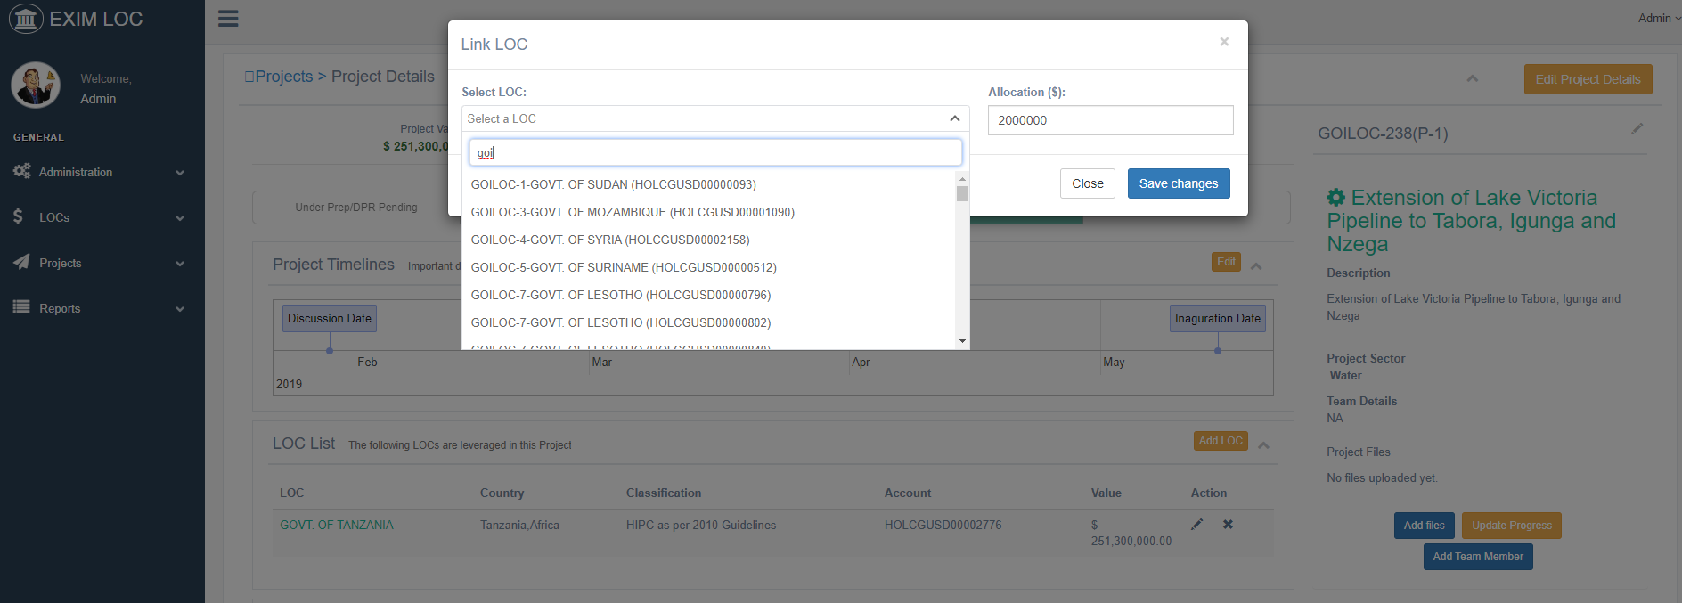
Project-Link to Funding LOC

Slide 18
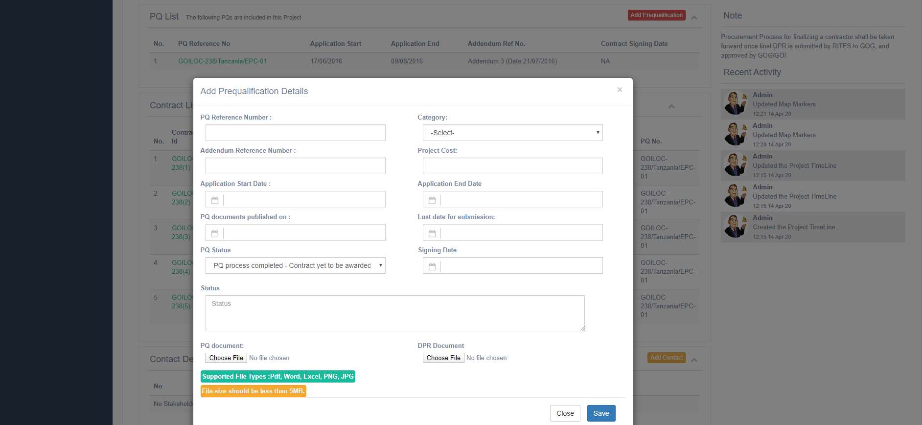
Project-Add Prequalification Process

Slide 19
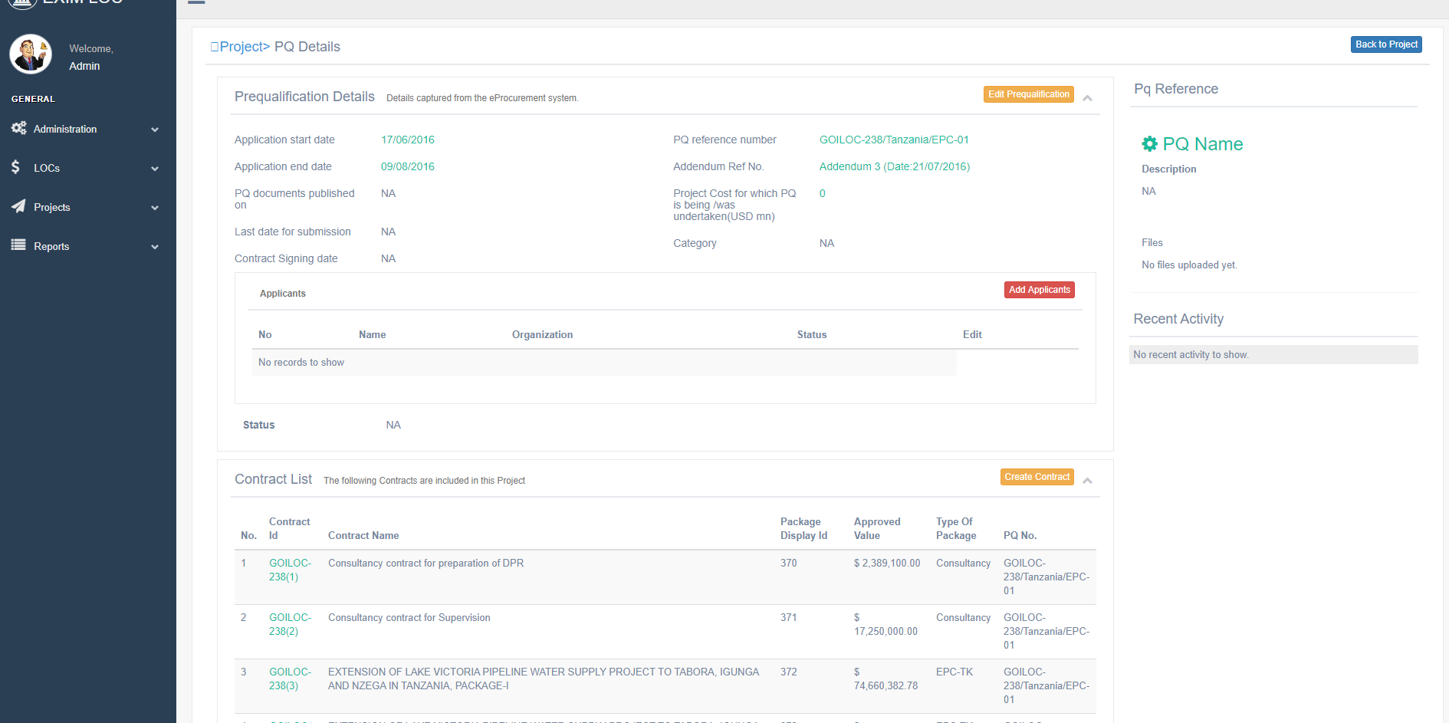
Project-PQ Details with Contract List

Slide 20
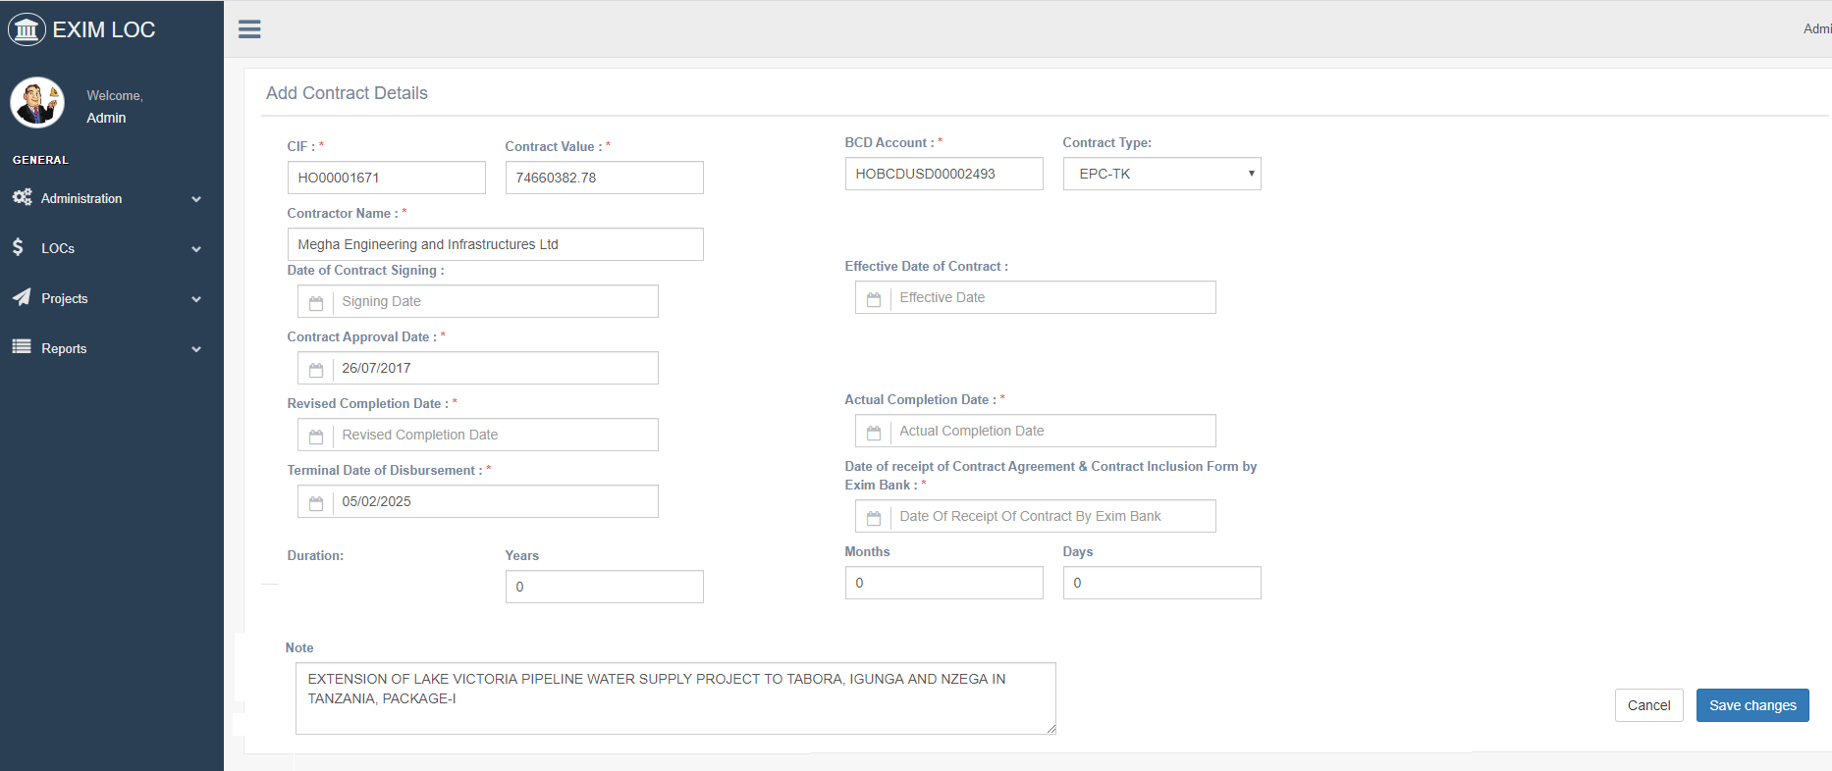
Projects-Add Contract under PQ

Slide 21
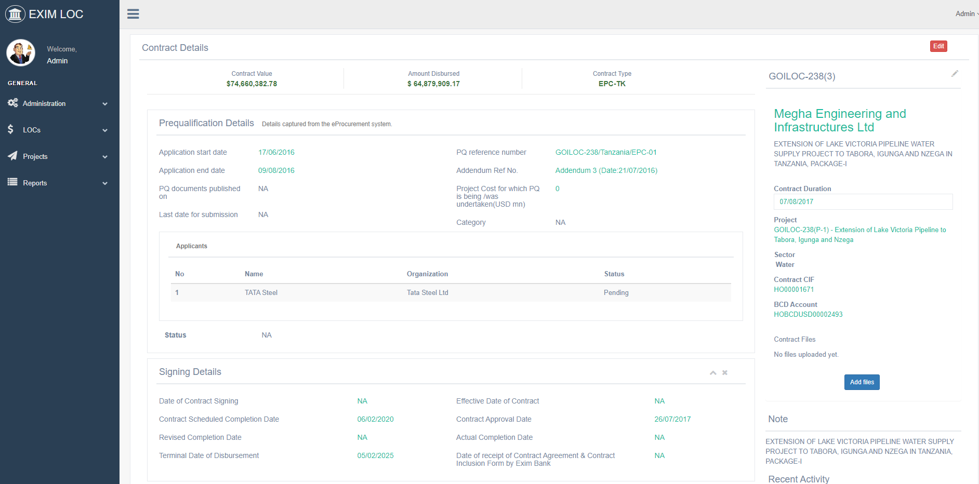
Contract-Details

Slide 22
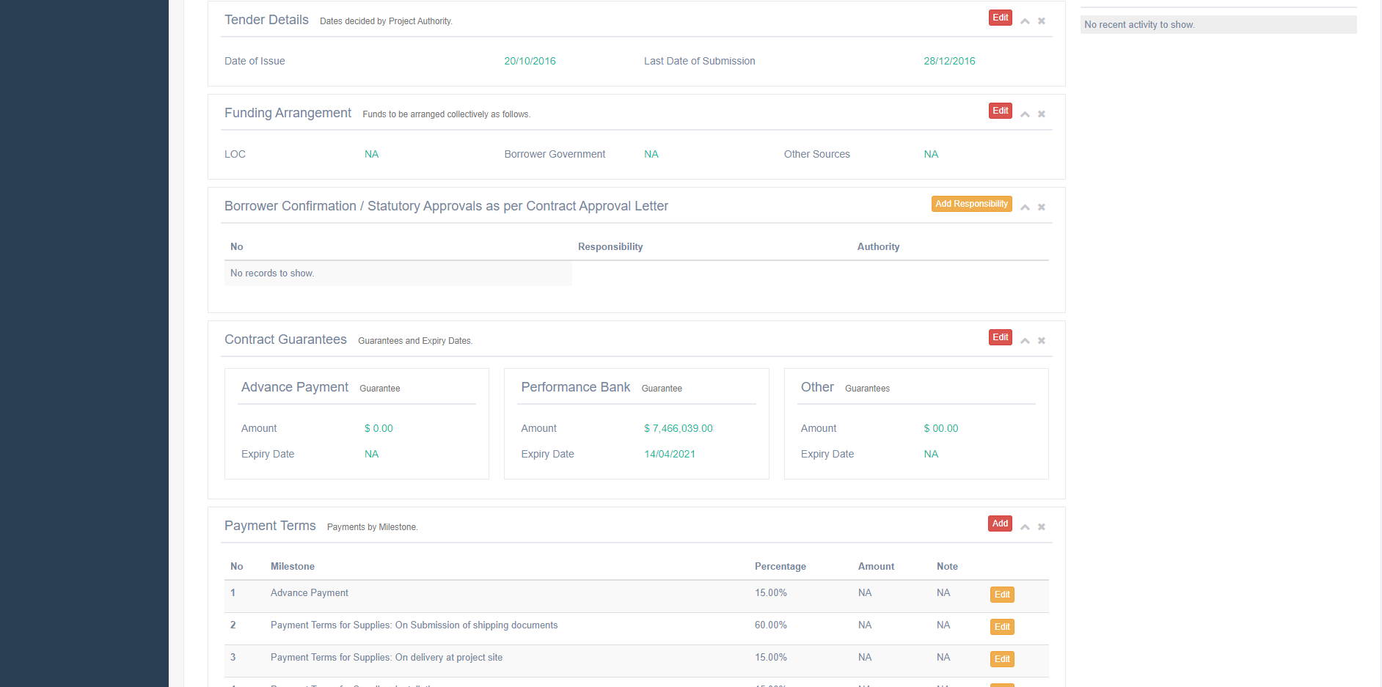
Contract-Tender Details, Funding Arrangement, Approvals, Guarantees, & Payment Terms

Slide 23
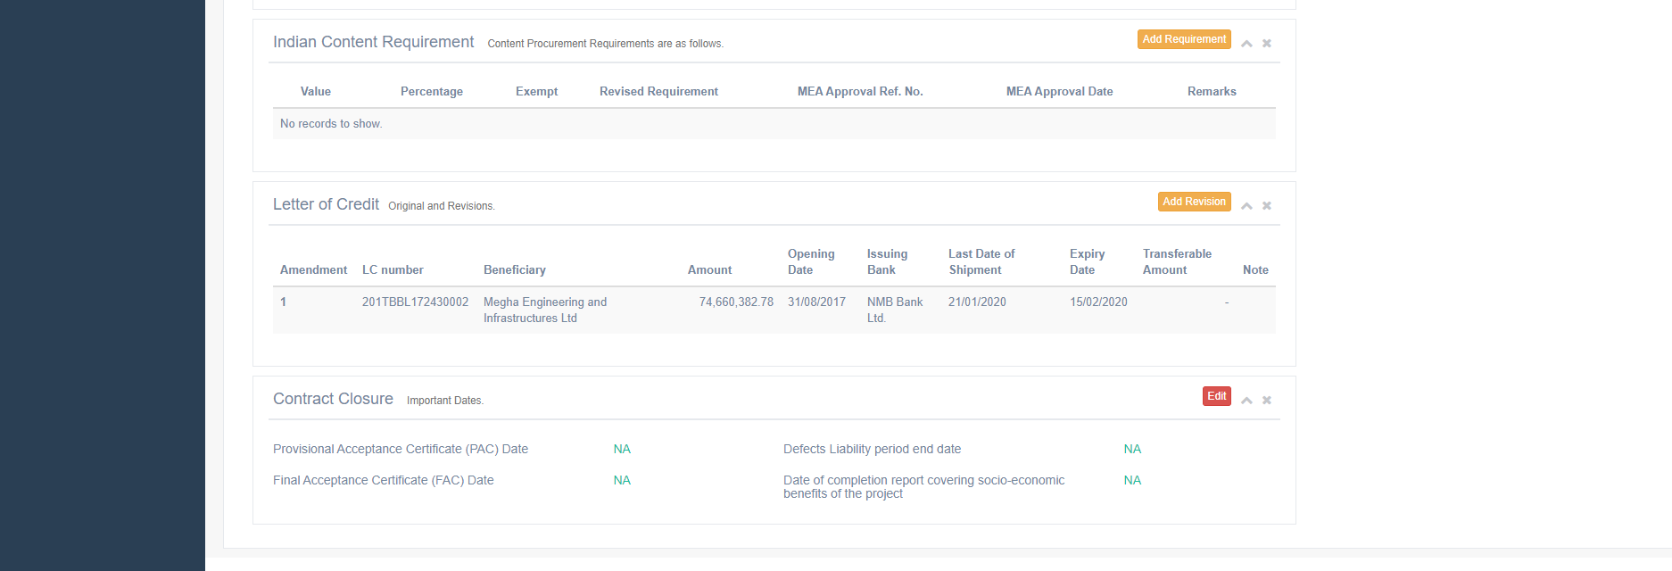
Contract-Content Requirements, Letter of Credit, & Closure Details

Slide 24
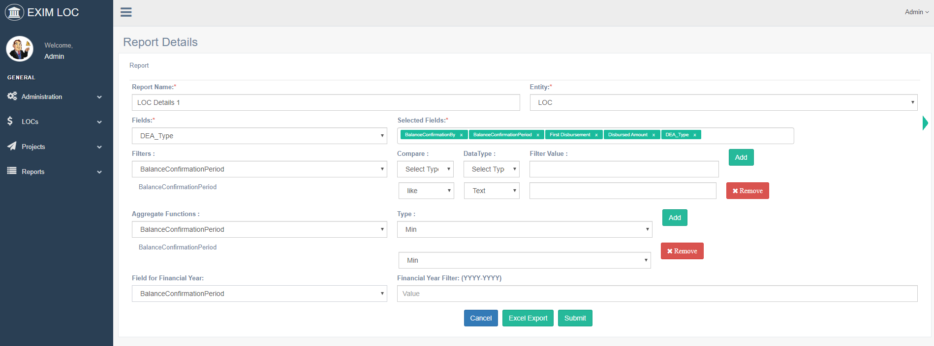
Reports- Custom Report Builder

Slide 25
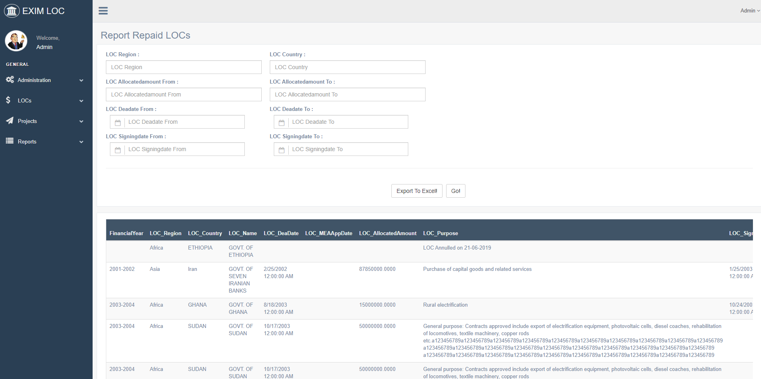
Reports- User created Custom Report

Slide 26
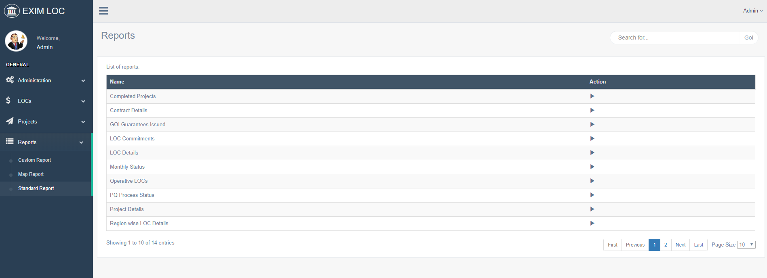
Reports-Fixed Standard Reports

Slide 27
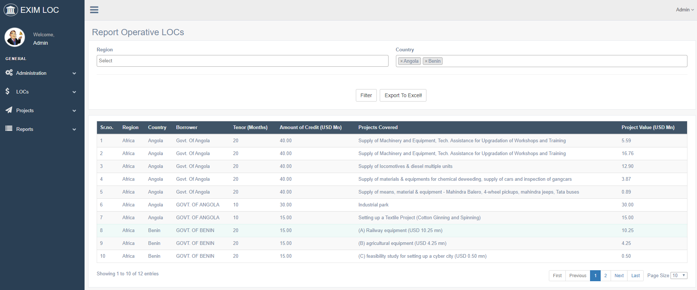
Reports-Fixed Standard Reports Example

Slide 28
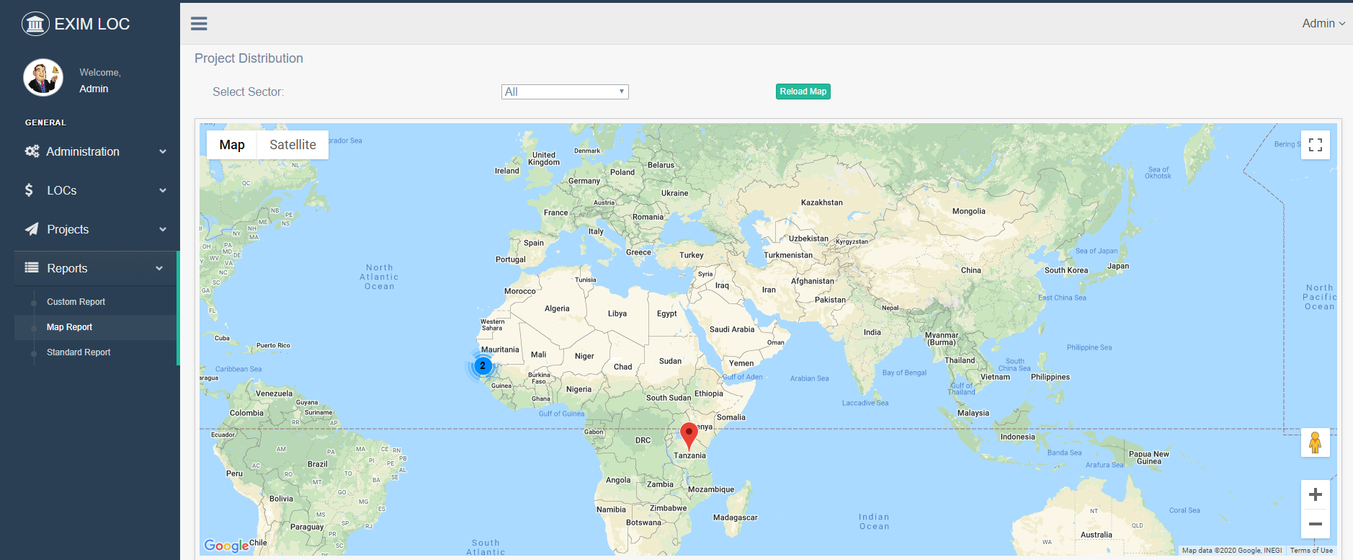
Reports-Map with global Project Distribution/Density

Slide 29
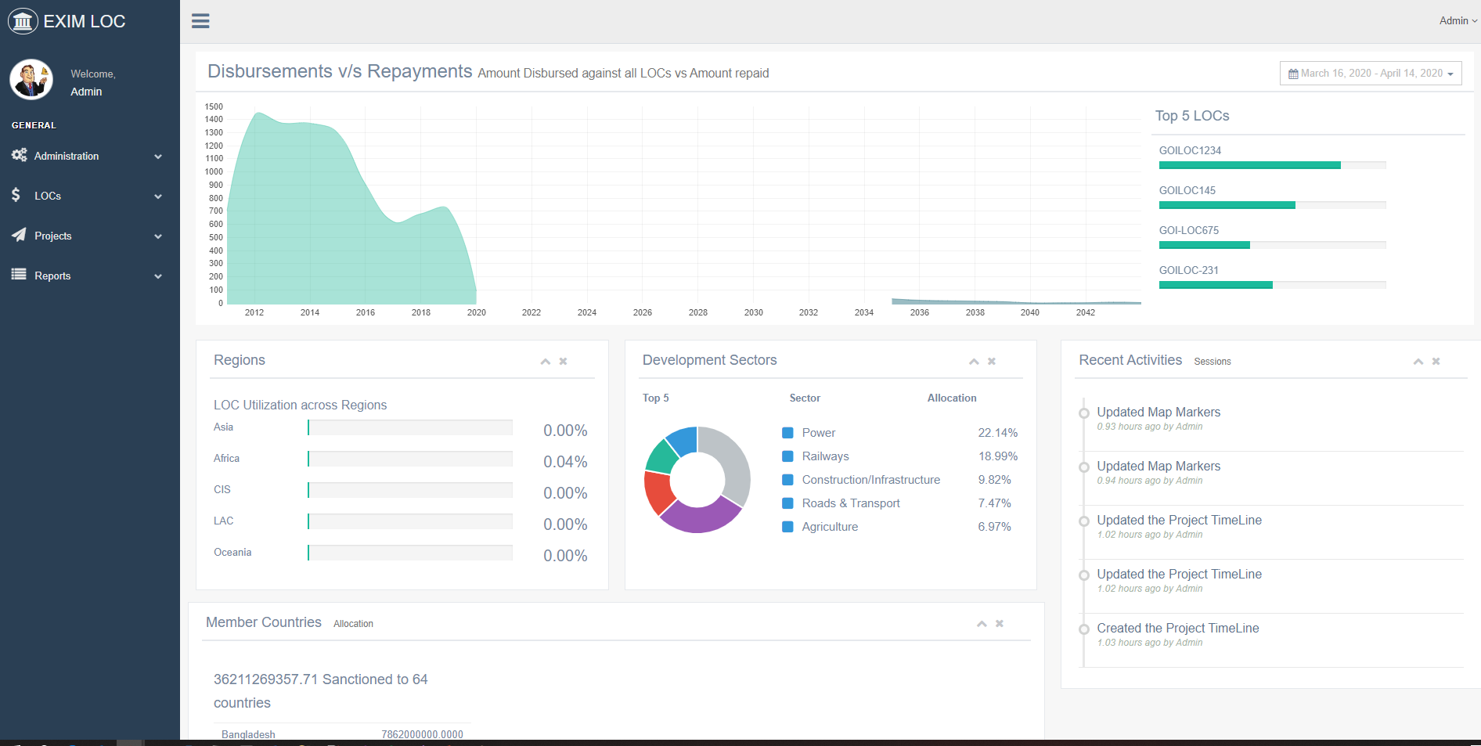
Dashboard-An overview of important parameters.

